Slide 1

CAPSTONE PROJECT
Integrated Analytics with Azure Synapse PRESENTER: YATISHKUMAR PATIL

Slide 2
Introduction:
Azure Synapse Analytics is a cloud-based data warehousing and analytics service. It enables businesses to ingest, prepare, manage, and serve data for analytics. With its integrated analytics capabilities, it offers businesses a powerful and unified platform to handle all their data processing and analytics needs.
This project aims to explore the various features and capabilities of Azure Synapse Analytics for integrated data analytics. By leveraging this service, businesses can streamline their data management and analytics processes, reduce costs, and gain valuable insights into their data.

Slide 3
Problem statement 1 : Ingest data with a pipeline
Our task is to explore data analytics workspace by using Azure Synapse Analytics.
We need to create ADLS Gen 2 accounts and define pipelines to transfer data from various data sources into the workspace for analysis.
Our goal is to ingest data into Azure Synapse Analytics using the Built-in copy task option.

Slide 4
Problem statement 1 : Ingest data with a pipeline
Azure Synapse Analytics allows us to define pipelines for ingesting data from various sources into the workspace.
We can configure settings for the dataset, source, destination, and file format in the Copy Data tool.
By monitoring pipeline progress on the Monitor page, we can ensure data is successfully ingested into Azure Synapse Analytics.

Slide 5
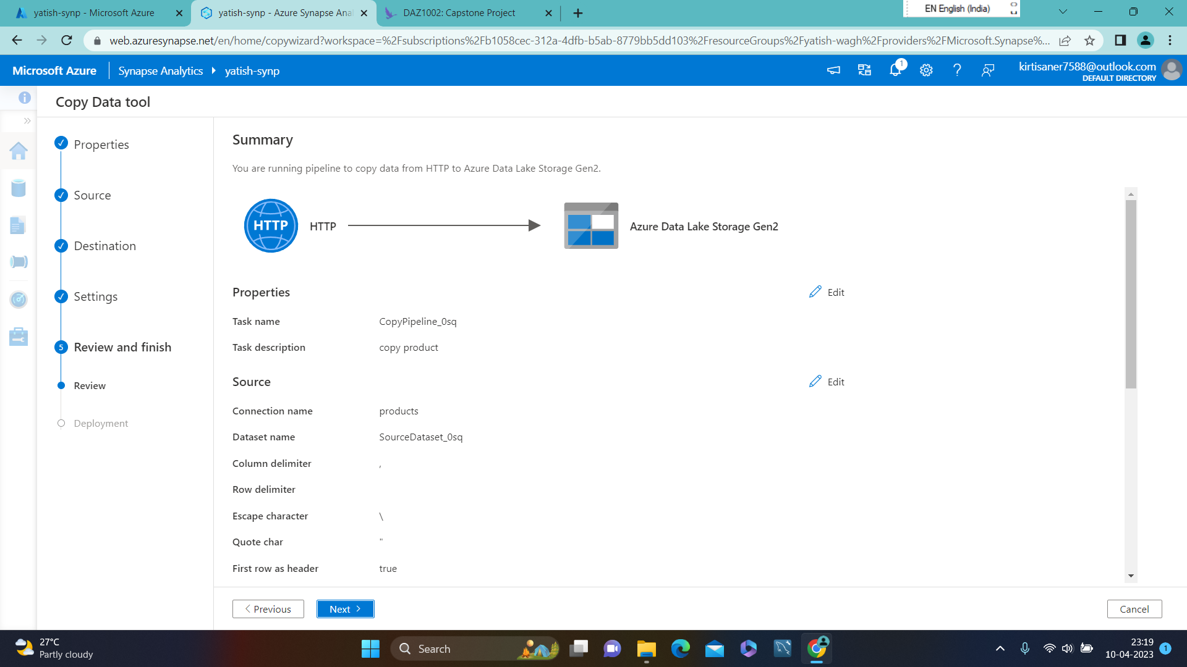
Running pipeline to copy data from HTTP to ADLS GEN2

Slide 6
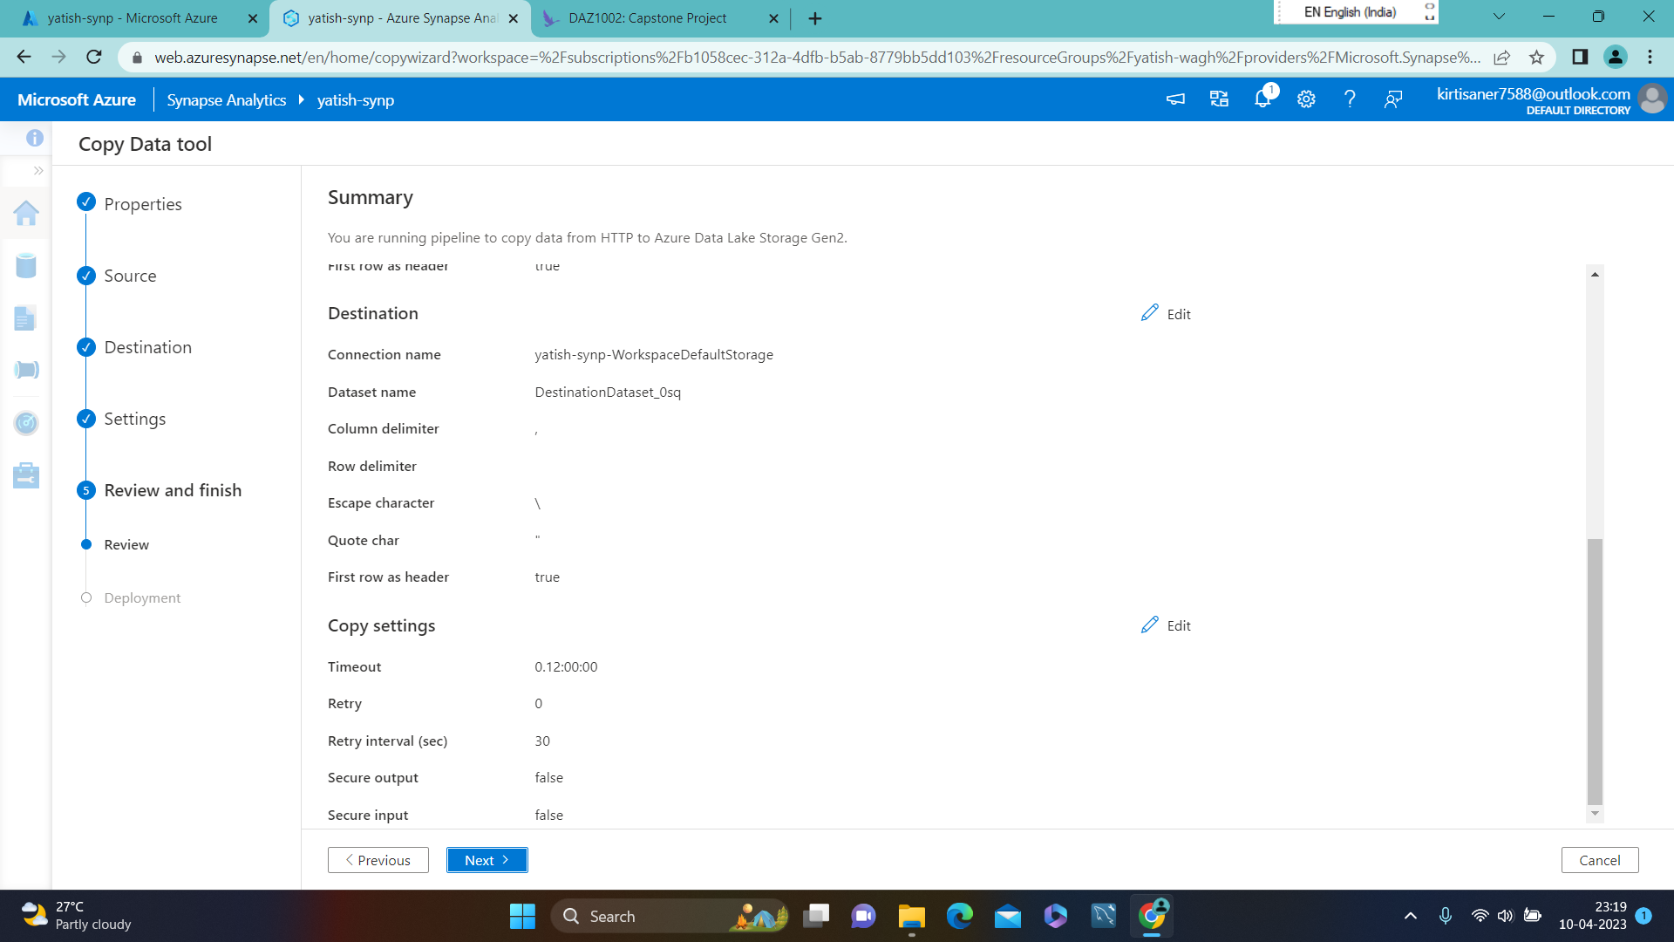

Slide 7
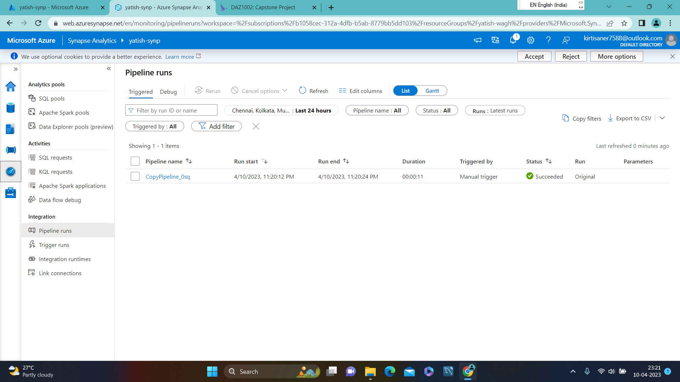
Monitor page : copypipeline.0sq status succeeded

Slide 8
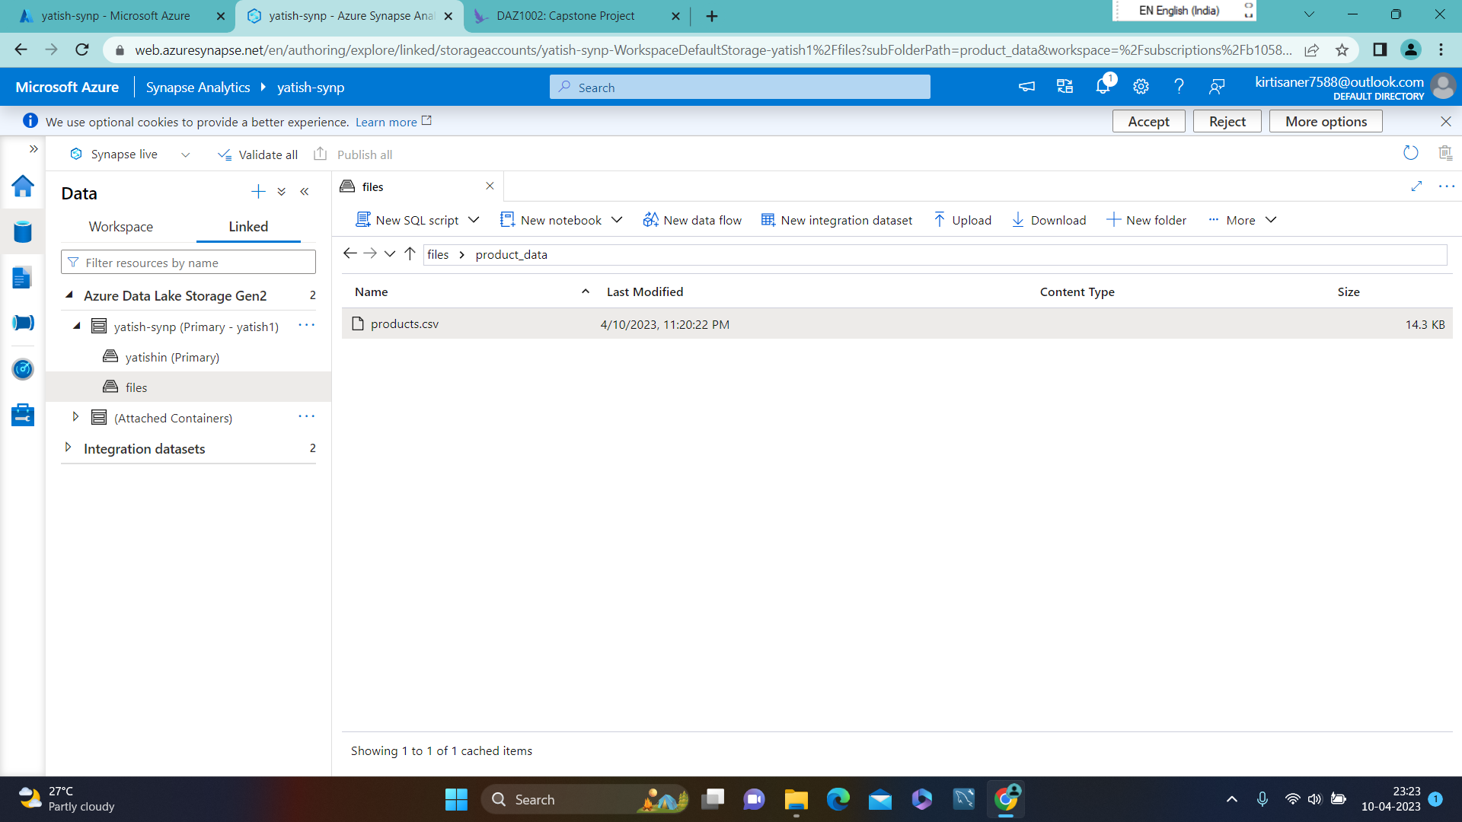
Data page : products.csv has been copied

Slide 9
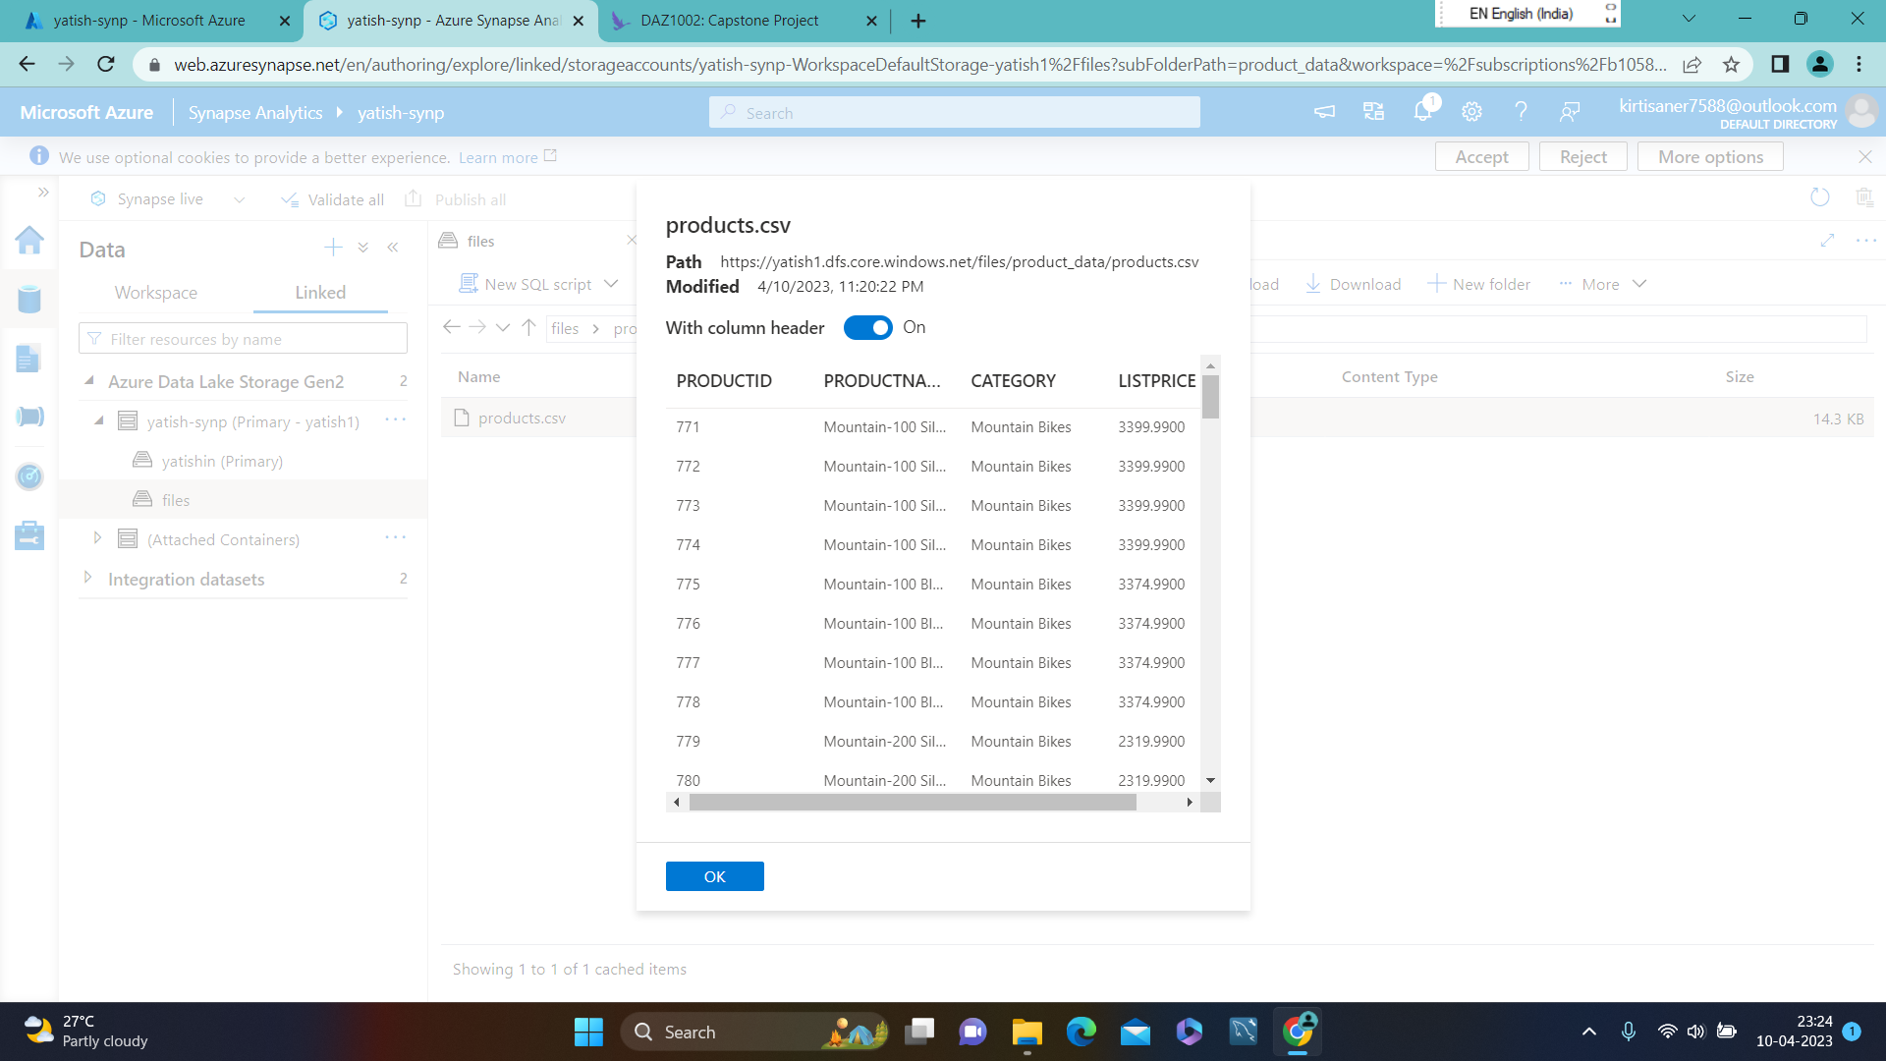
PREVIEW OF COPIED DATA

Slide 10
Problem statement 2 : Use a serverless SQL pool to analyze data
In Synapse Analytics, you can use a serverless SQL pool to query and analyze data stored in a data lake. you can use the Synapse Studio to create a new SQL script and run SQL code against a dataset.
By using Synapse Studio, you can easily create, modify, and publish SQL scripts, aggregate data, and create visualizations.
With the flexibility and scalability of Synapse Analytics, you can handle large amounts of data and gain valuable insights.

Slide 11
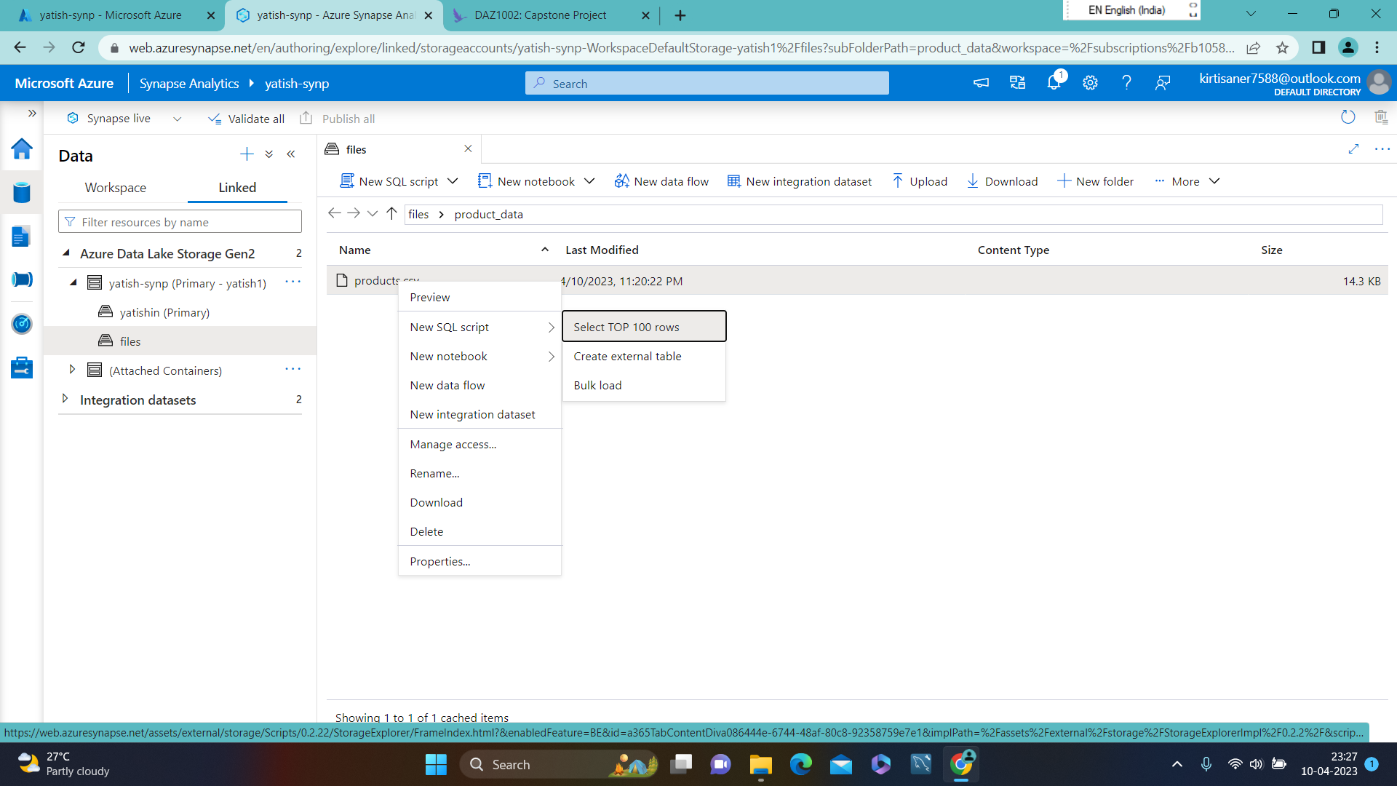
NEW SQL SCRIPT TO SELECT TOP 100 ROWS

Slide 12
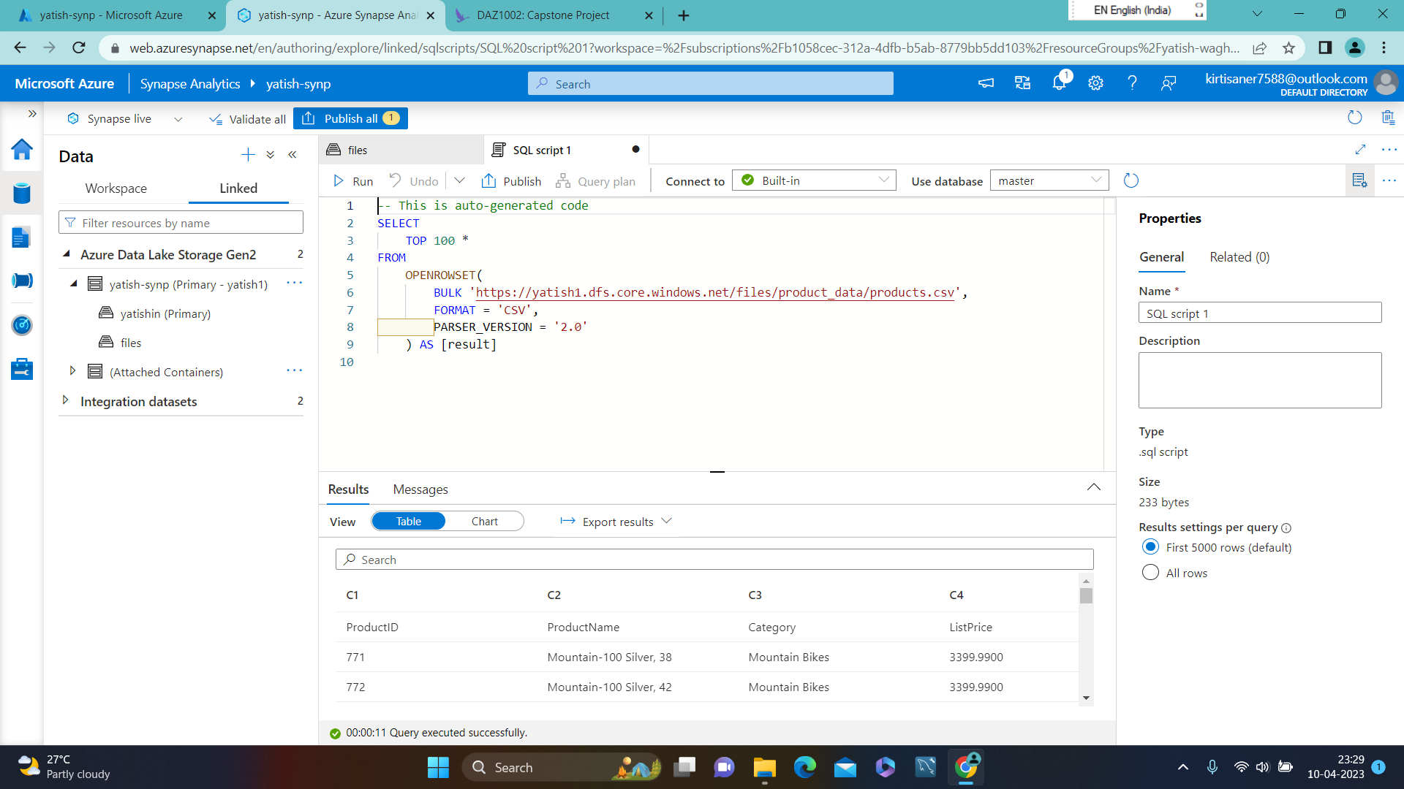
AUTO GENERATED CODE FOR TOP 100 ROWS

Slide 13
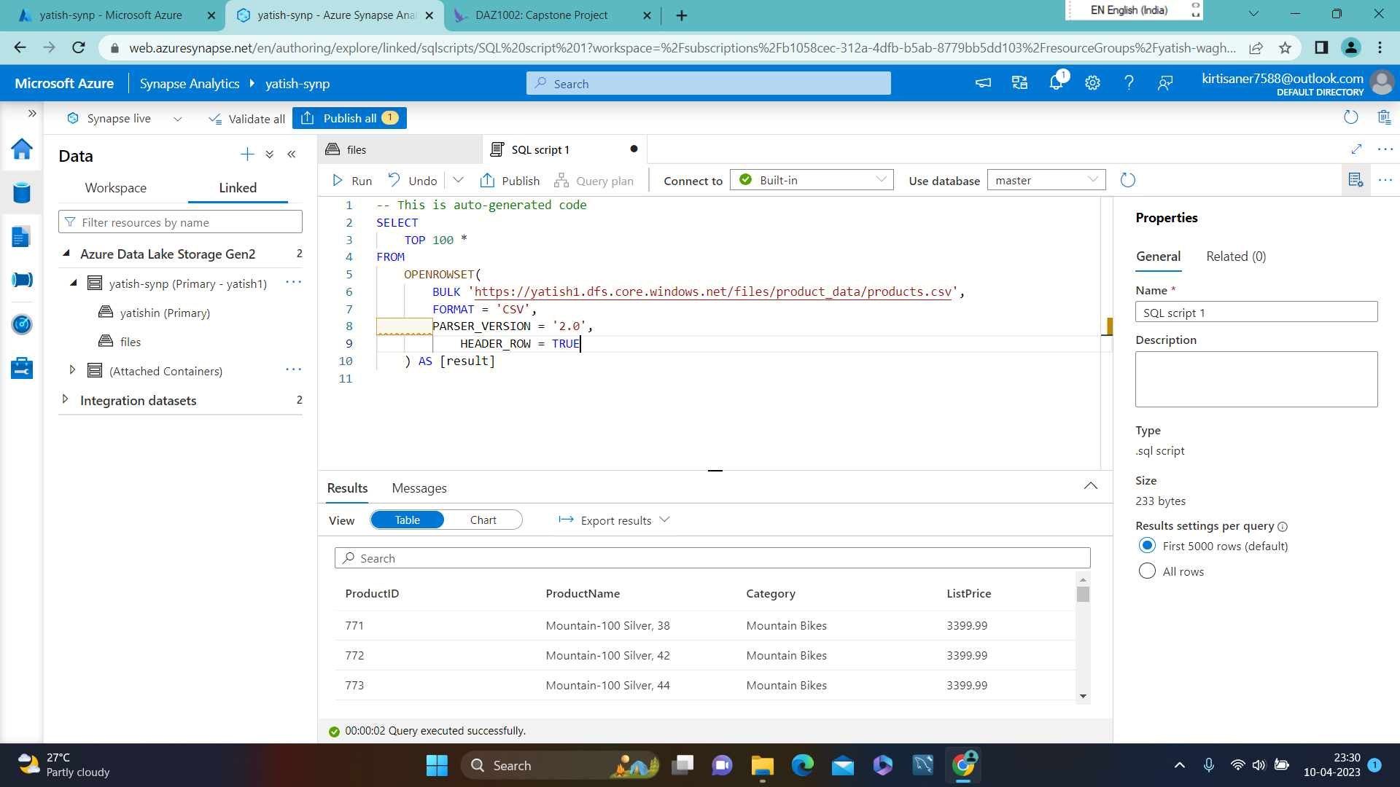
MODIFIED CODE WITH HEADER ROW = TRUE

Slide 14
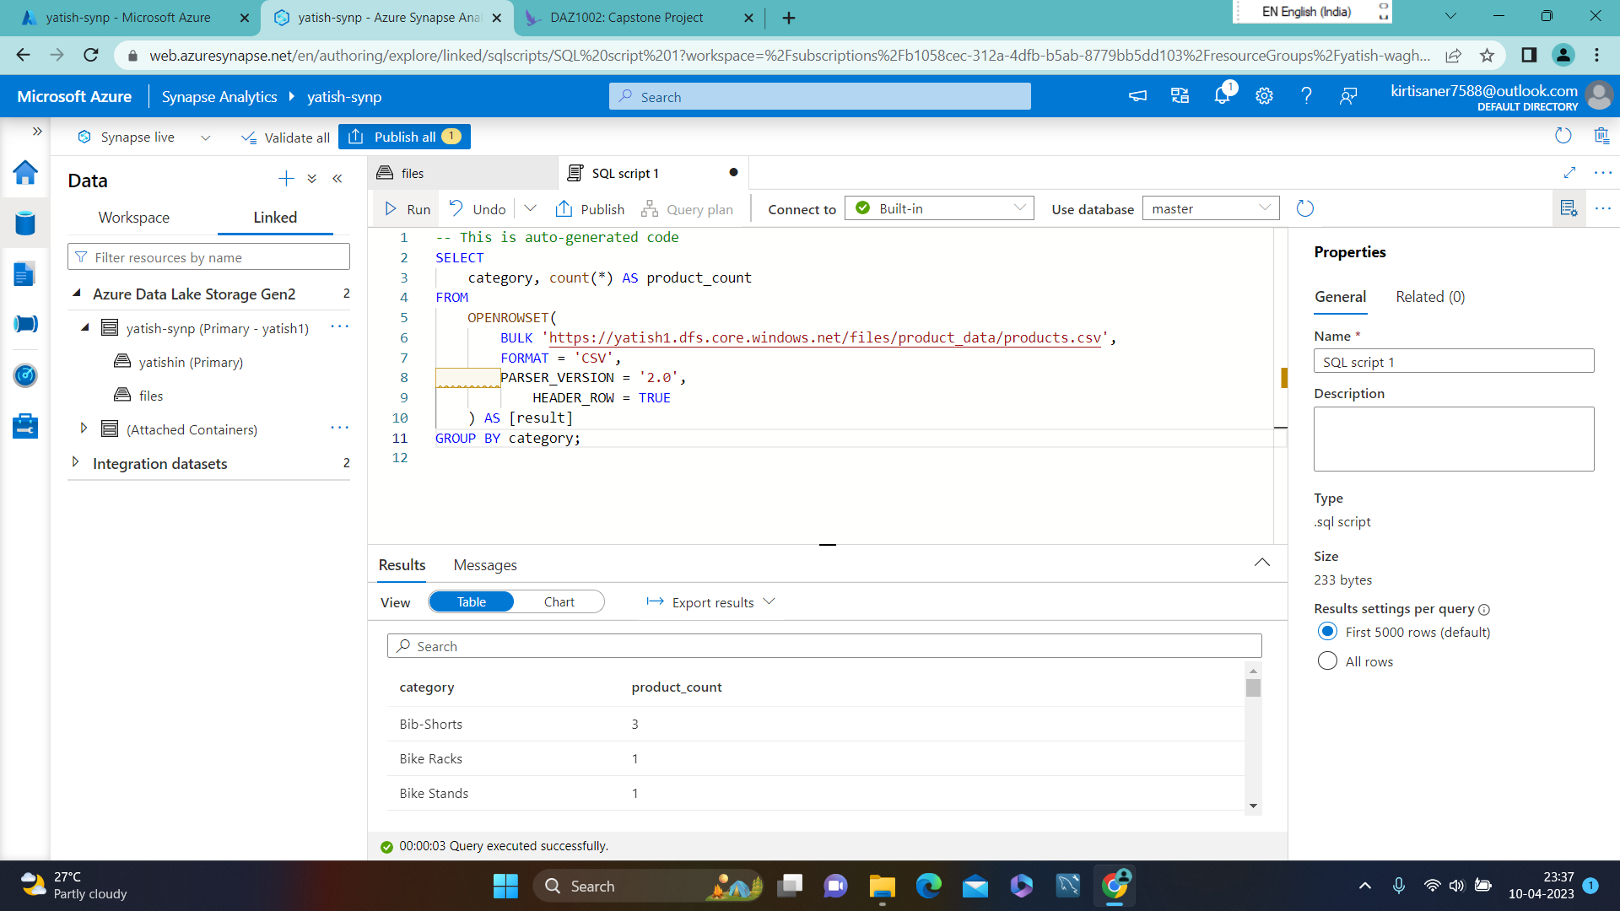
MODIFIED QWERY TO COUNT PRODUCTS BY CATEGORY

Slide 15
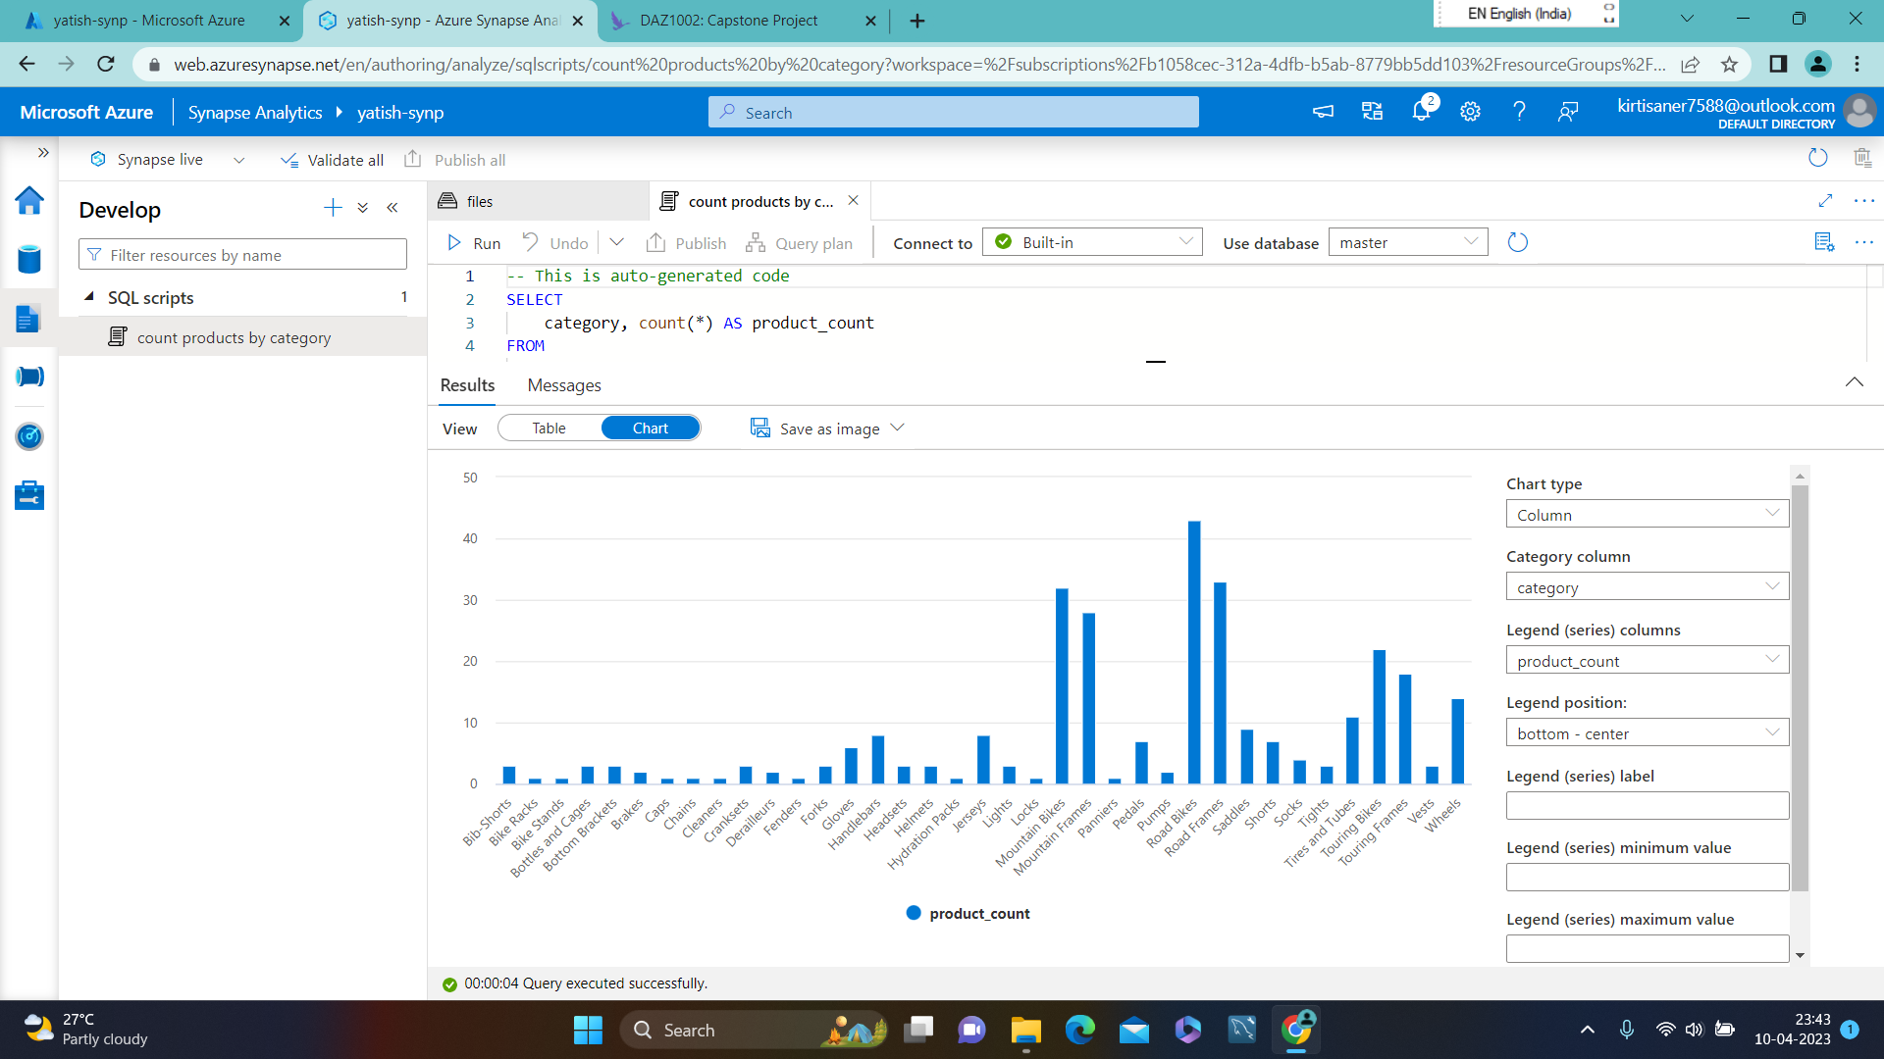
VISUALISATION OF COUNT PRODUCTS BY CATEGORY

Slide 16
Problem statement 3 : Use a Spark pool to analyze data
In Azure Synapse Analytics, you can use a Spark pool to analyze and process data using Python.
With Synapse Studio, you can easily load data from your data lake into a Dataframe , which can then be used for data analysis and manipulation. By selecting the appropriate Spark pool, you can execute Pyspark code and run data transformations.
the Spark pool in Synapse Analytics provides a powerful tool for data analytics to process and analyze large datasets using Python

Slide 17
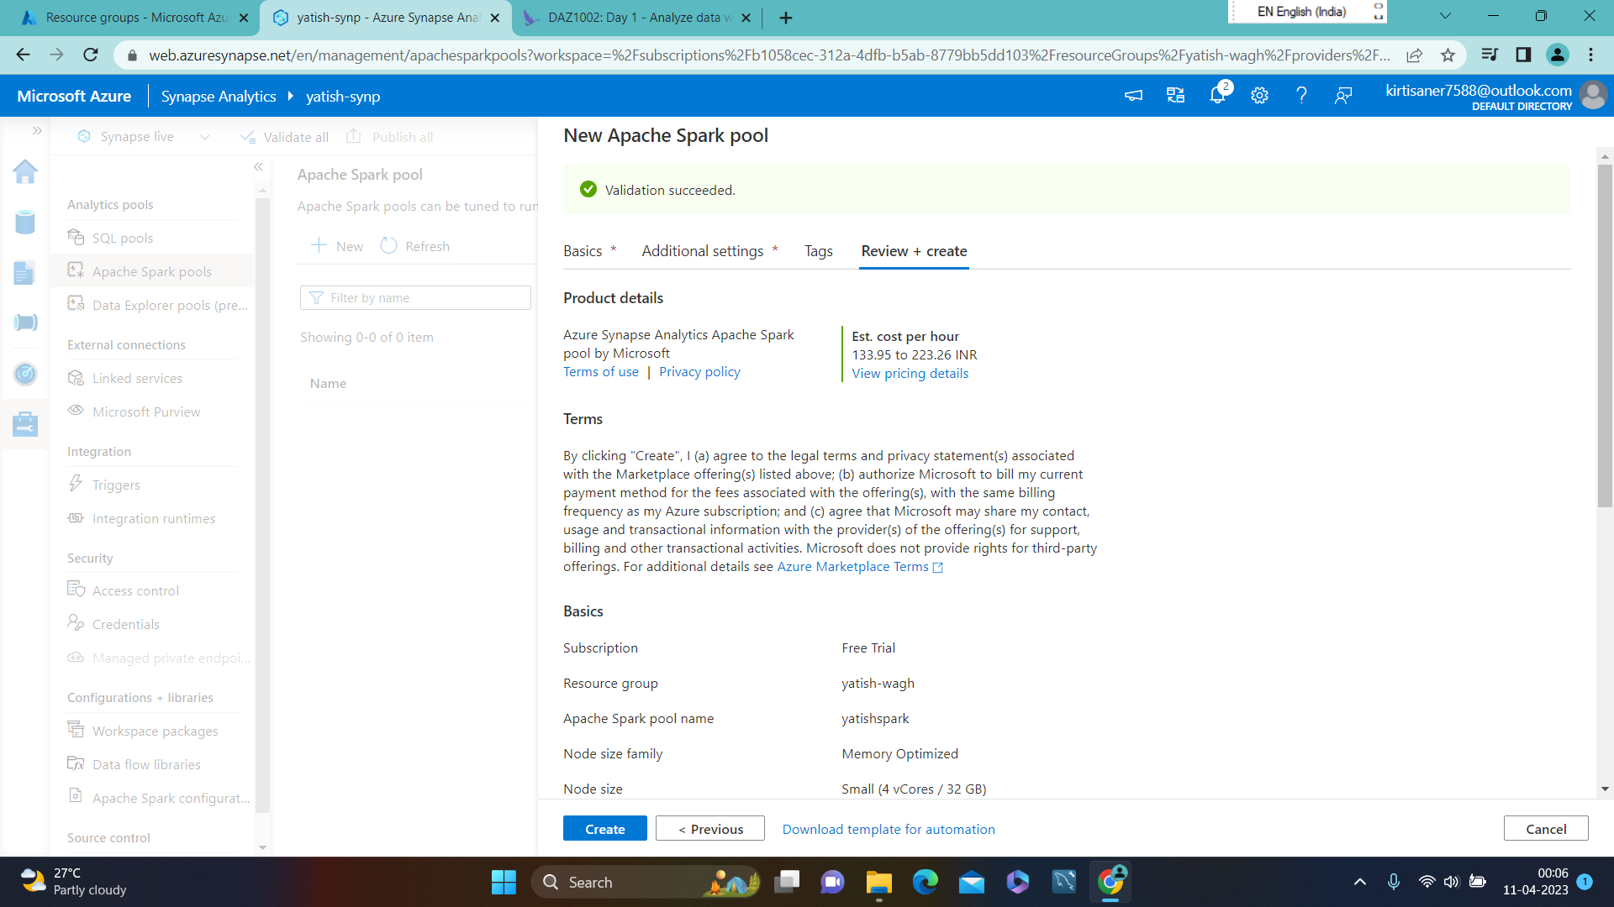
CREATED NEW APACHE SPARK POOL

Slide 18
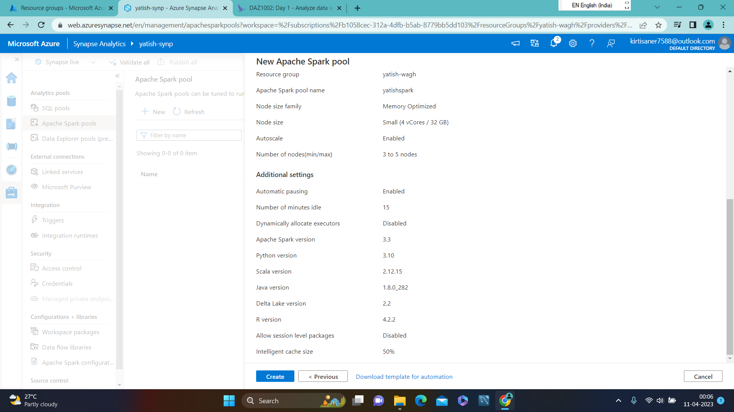
CREATED NEW APACHE SPAK POOL

Slide 19

SELECTING NEW NOTEBOOK AND LOADING TO DATAFRAME

Slide 20
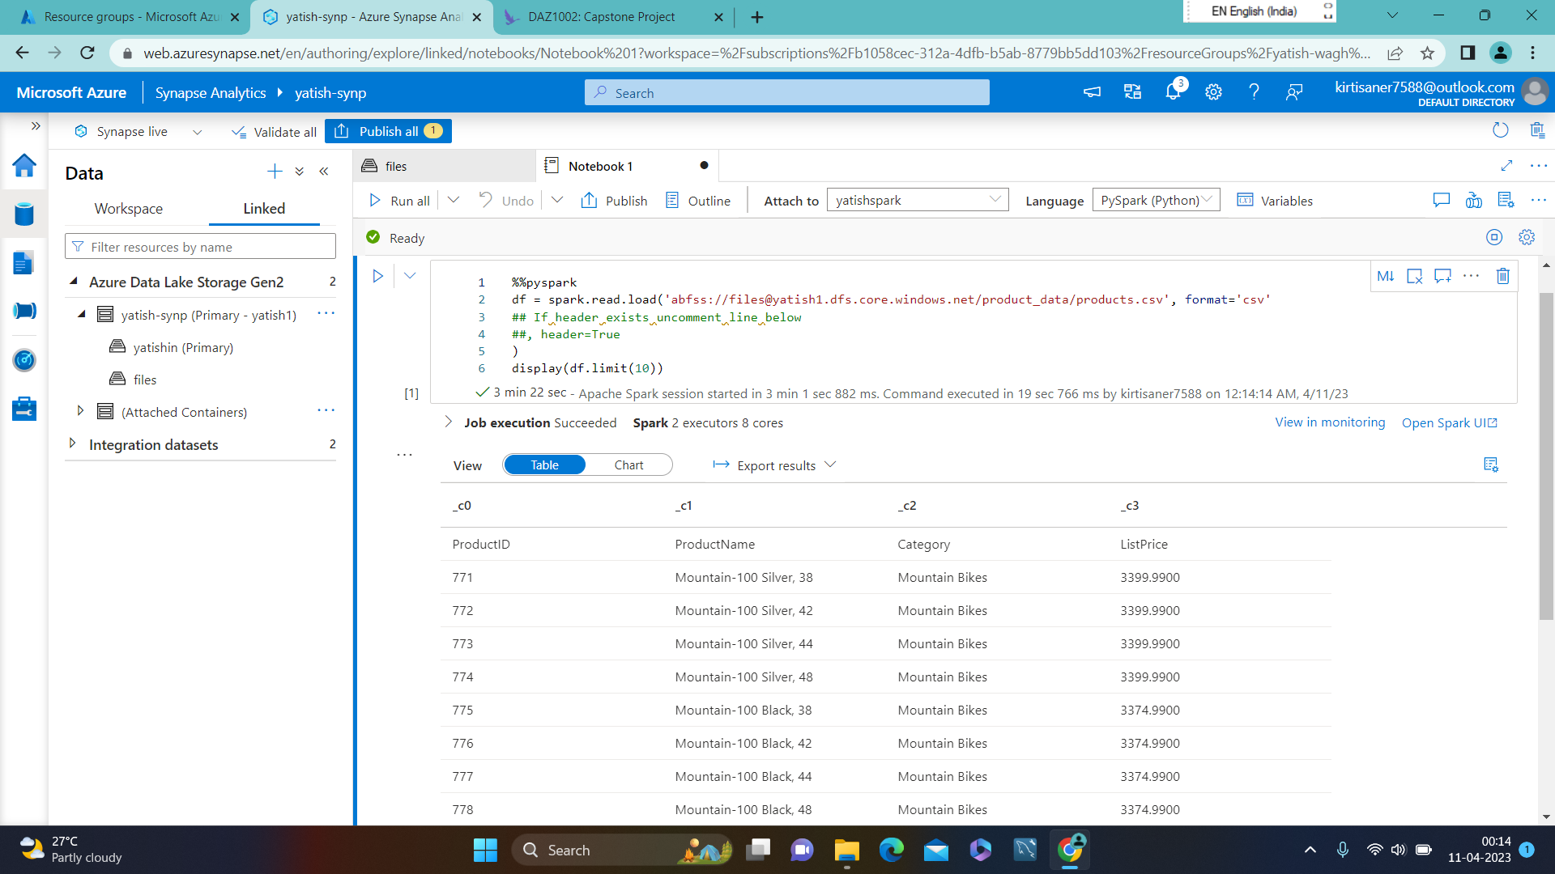
NOTEBOOK 1 ATTACHED TO YATISHSPARK

Slide 21

UNCOMMENTED HEADER = TRUE

Slide 22
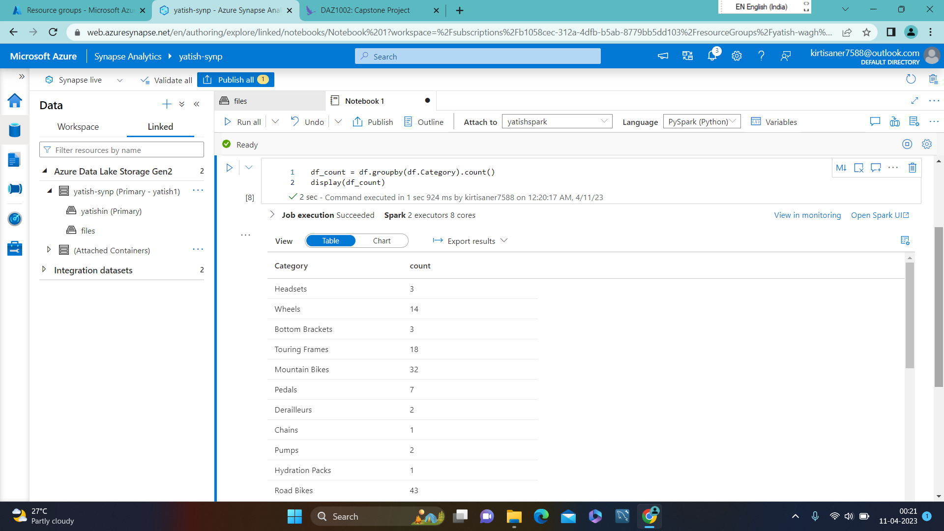
CODE TO COUNT PRODUCTS BY CATEGORY

Slide 23
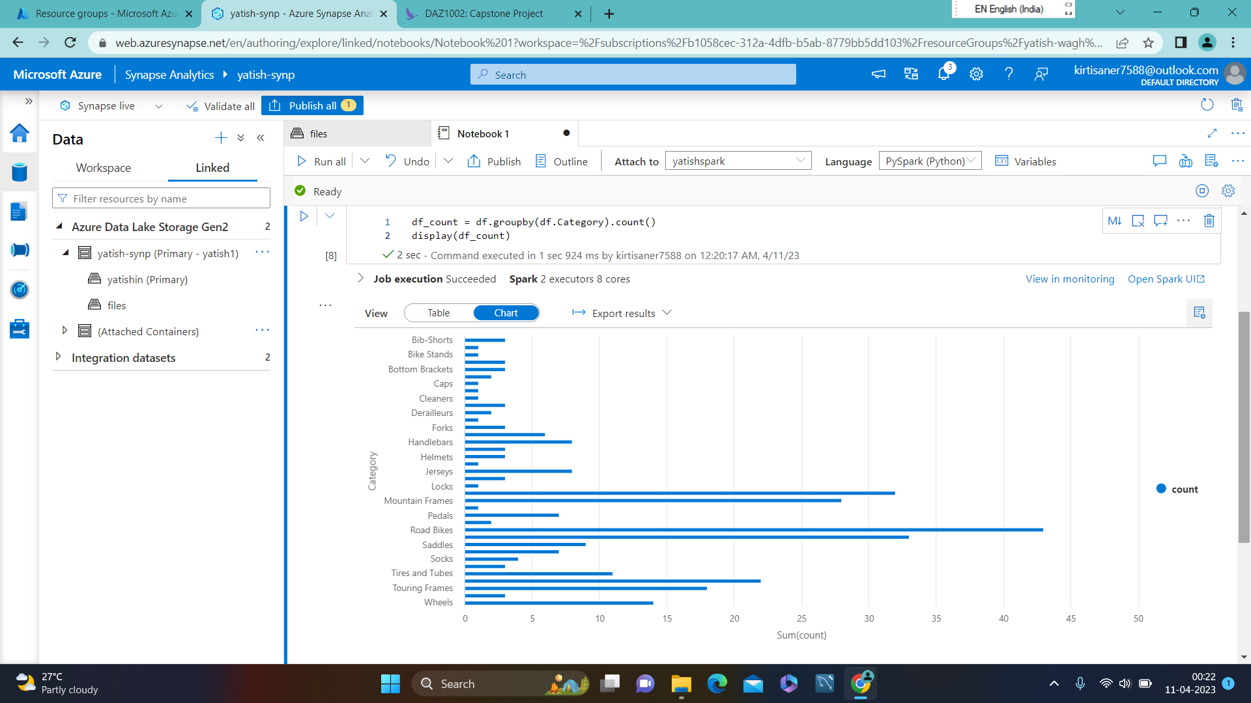
BAR CHART FOR COUNT PRODUCT BY CATEGORY

Slide 24
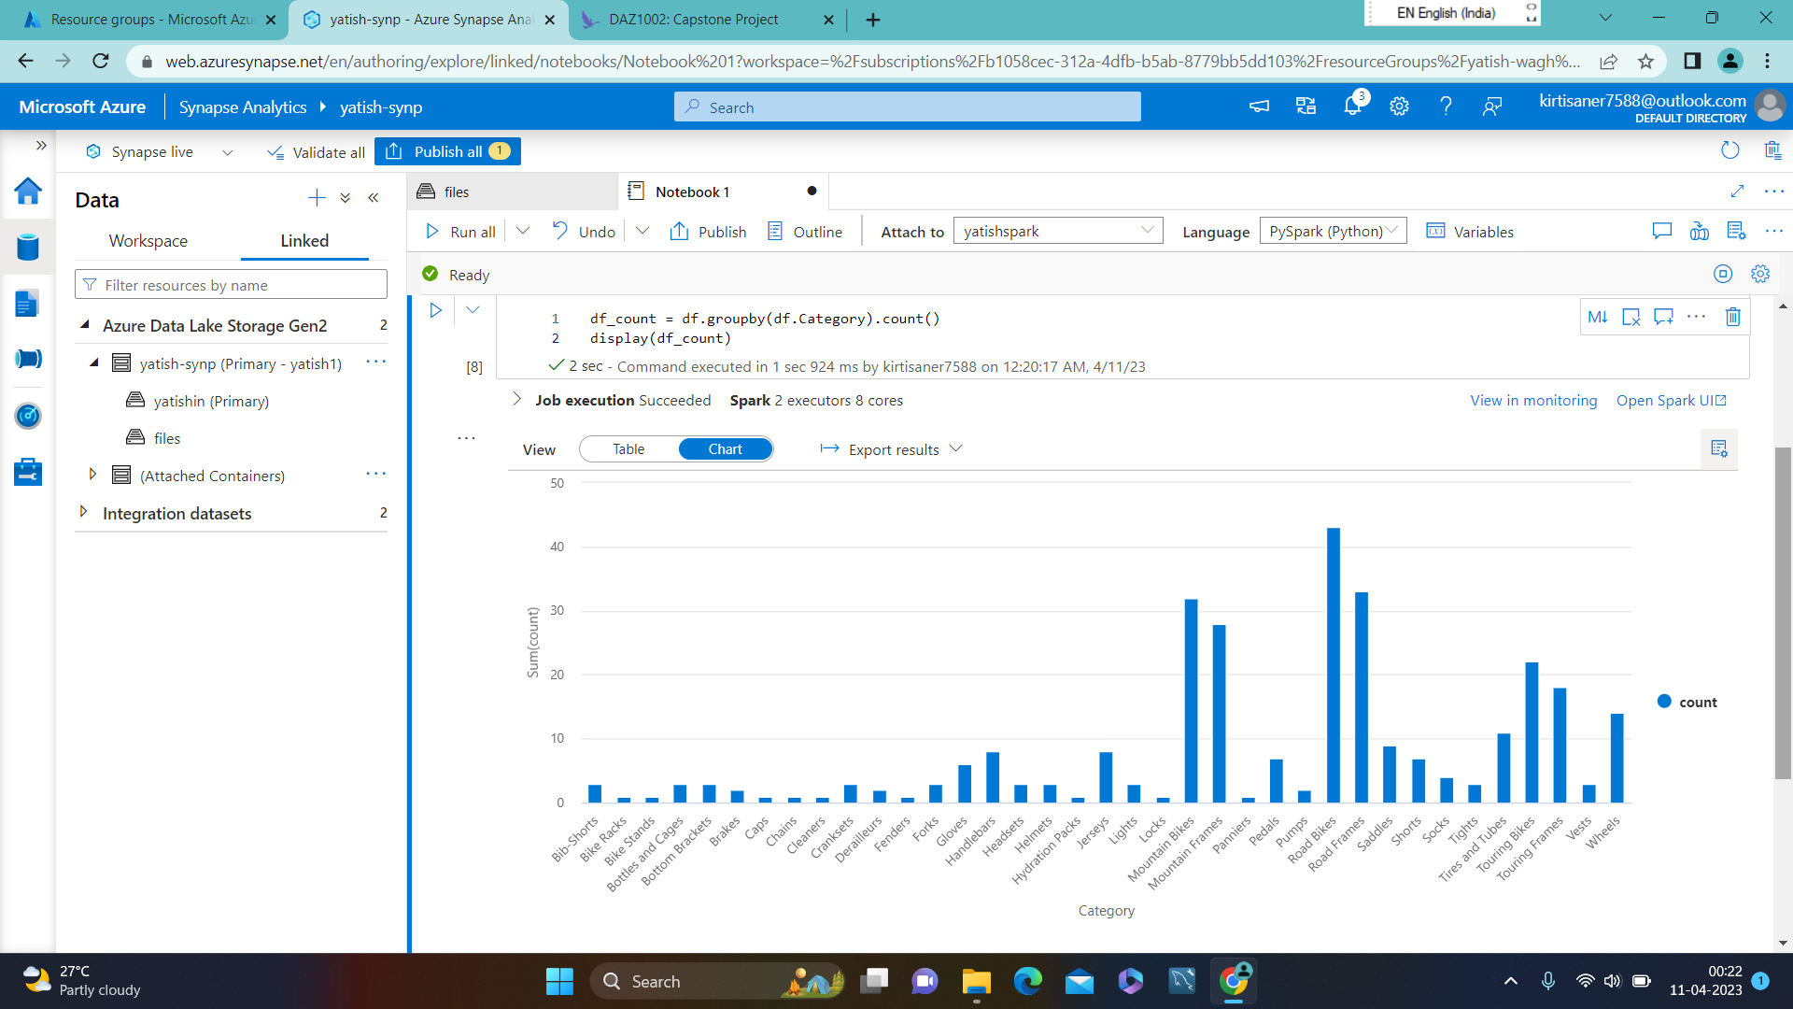
COLUMN CHART FOR COUNT PRODUCTS BY CATEGORY

Slide 25
Summary :
1. Azure Synapse workspace has been created.
2. Ingested the data choosing HTTP
3. SQL pool has been used to analyze the data.
4. Spark pool has been used to analyze the data.
5. Code Snippet added to both the pool for analyzing the data.

Slide 26
THANK YOU

